Slide 1
Intro to M Programming
Ted Pattison
Principal Program Manager
Customer Advisory Team (CAT) at Microsoft

Slide 2
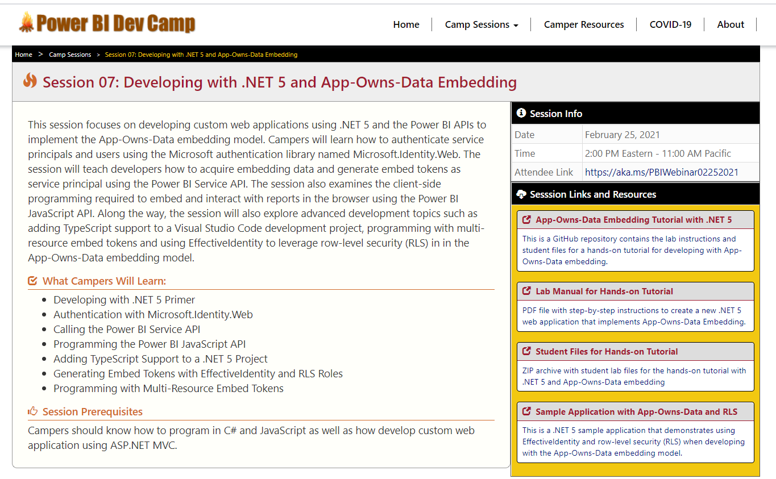
Welcome to Power BI Dev Camp
Power BI Dev Camp Portal - https://powerbidevcamp.net

Slide 3

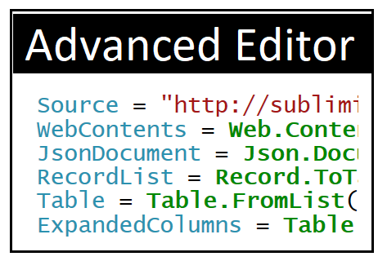
Using the Advanced Editor

Slide 4
Agenda
The Power Query Mashup Engine
M Programming Fundamentals
Choosing Between OData.Feed & Web.Contents
Introduction to Custom Connectors
Importing Data from the Microsoft Graph API
Signing and Deploying Custom Connectors

Slide 5
Power Query is an ETL Tool
ETL process is essential part of any BI Project
Extract the data from wherever it lives
Transform the shape of the data for better analysis
Load the data into dataset for analysis and reporting
CSV
File
Power Query
Mashup Engine
Power BI Desktop Project (PBIX)
Dataset
Excel
Workbook
OLTP
Database

Slide 6
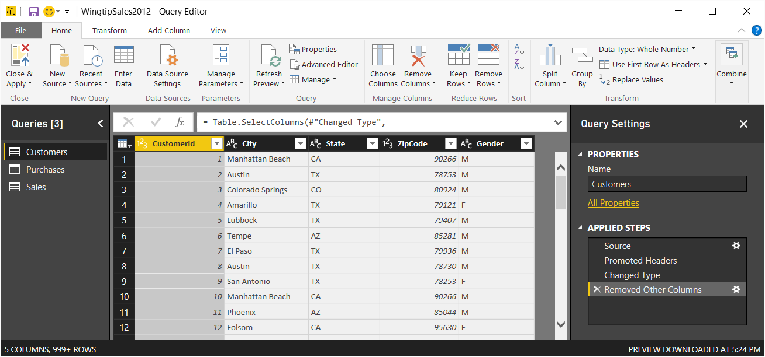
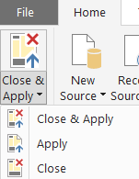
Query Editor Window
Power BI Desktop provides separate Query Editor window
Provides easy-to-use UI experience for designing queries
Queries created by creating Applied Steps
Preview of table generated by query output shown in the middle
Query can be executed using Apply or Close & Apply command

Slide 7
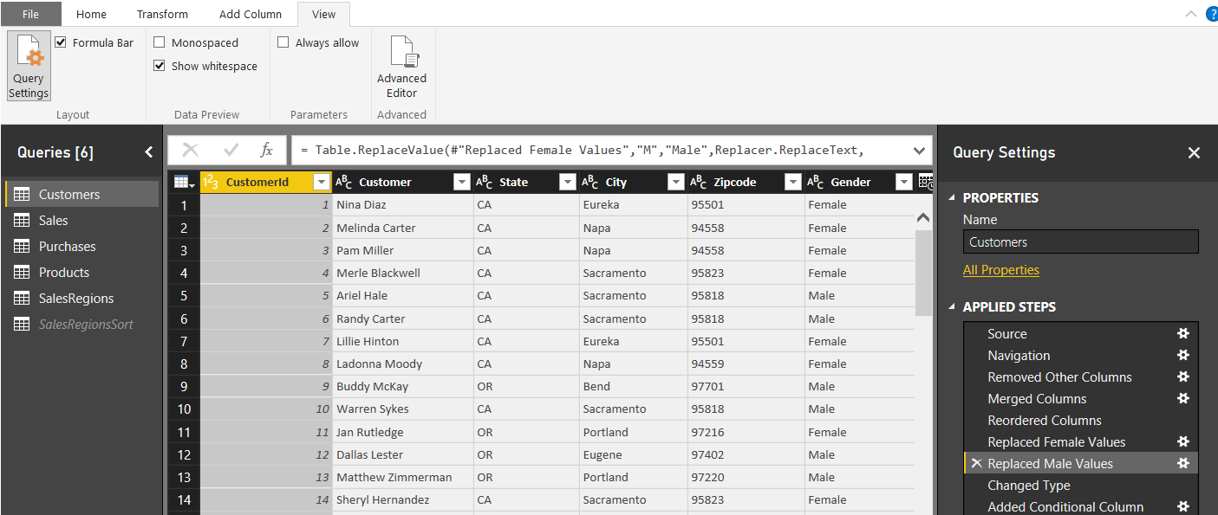
Query Steps
A query is created as a sequence of steps
Each step is a parameterized operation in data processing pipeline
Query starts with Source step to extract data from a data source
Additional steps added to perform transform operations on data
Each step is recorded using M (aka Power Query Formula Language)
step formula bar
sequential list of steps for query

Slide 8
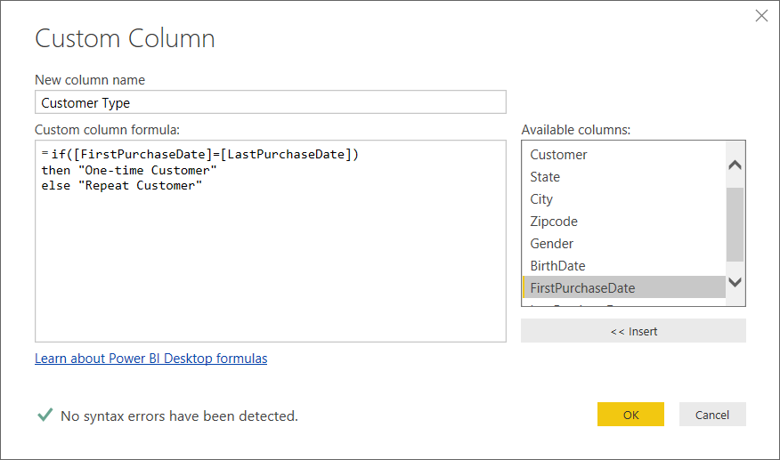
Custom Column Dialog
You can write M code directly for custom column
The Custom Column dialog provides a simple M code editor

Slide 9
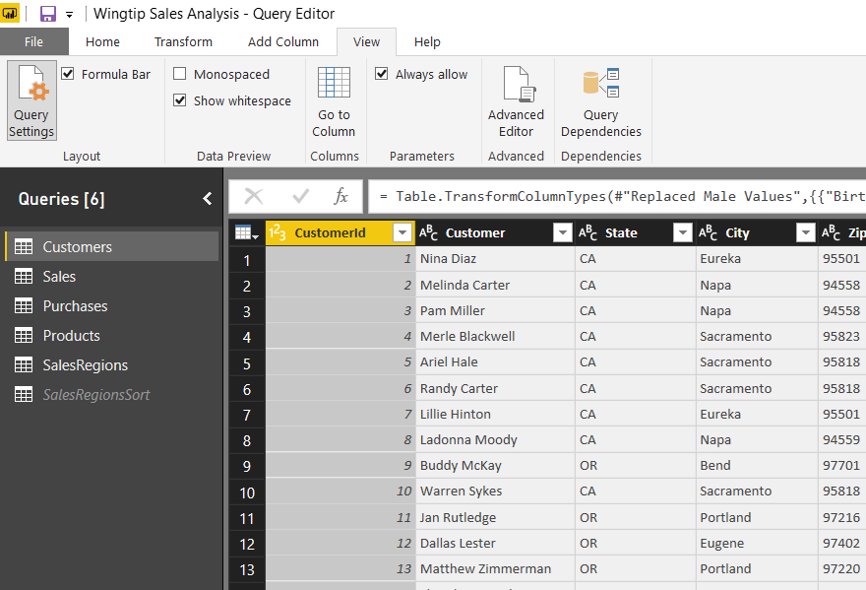
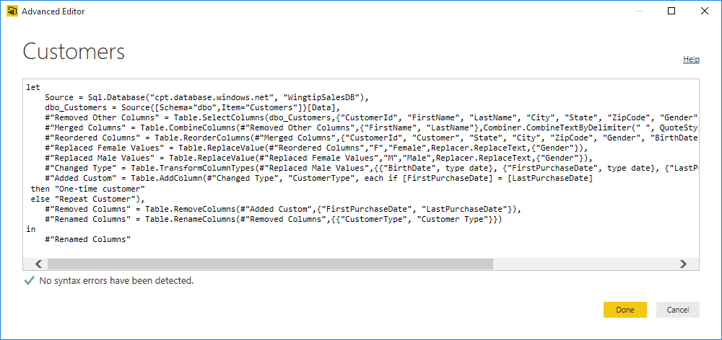
Advanced Editor or more correctly - The Simple Editor for Advanced Users
Power BI Desktop based on "M" functional language
Query in Power BI Desktop saved as set of M statements in code
Query Editor generates code in M behind the scenes
Advanced users can view & modify query code in Advanced Editor

Slide 10
Why Learn M
Accomplish things that cannot be done in query editor
Working with query functions
Performing calculations across rows
Navigate to SharePoint list by list title instead of GUID with the ID
Author queries and check them into source control system
Add query logic in .m files and store them in GitHub, TFS, etc.
Ensure query logic is the same across PBIX projects
Stay Ahead of the Pack and Win Admiration of Your Peers
People will think you are buddies with Chris Webb!

Slide 11
Agenda
The Power Query Mashup Engine
M Programming Fundamentals
Choosing Between OData.Feed & Web.Contents
Introduction to Custom Connectors
Importing Data from the Microsoft Graph API
Signing and Deploying Custom Connectors

Slide 12
The M Programming Language
M is a functional programming language
computation through evaluation of mathematical functions
Programming involves writing expressions instead of statements
M does not support changing-state or mutable data
Every query is a single expression that returns a single value
Every query has a return type
Get Started with M
Language is case-sensitive
It's all about writing expressions
Query expressions can reference other queries by name

Slide 13
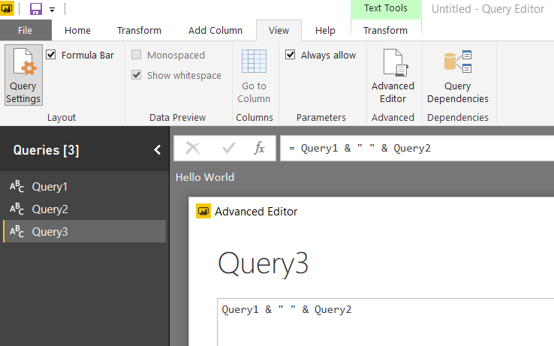
Referencing Other Queries
Query can reference other queries by name
Every query is defined with a return type

Slide 14
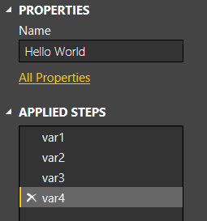
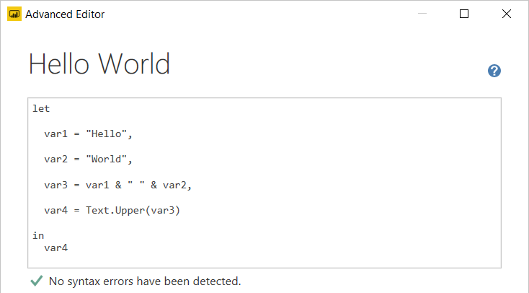
Let Statement
Queries usually created using let statement
Allows a single expressions to contain inner expressions
Each line in let block represents a separate expression
Each line in let block has variable which is named step
Each line in let block requires comma at end except for last line
Expression inside in block is returned as let statement value

Slide 15
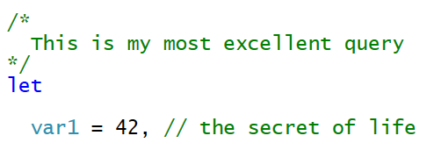
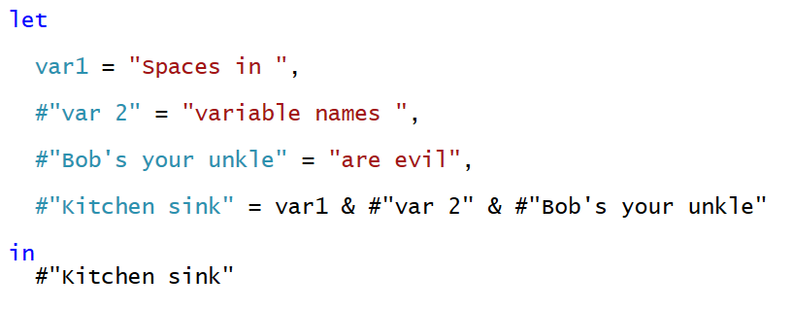
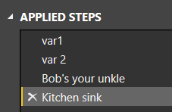
Comments and Variable Names
M supports using C-style comments
Multiline comments created using /* */
Single line comments created using //
Variable names with spaces must be enclosed in #" "
Variable names with spaces created automatically by query designer

Slide 16
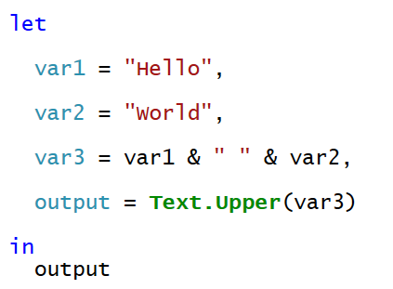
Flow of Statement Evaluation
Evaluation starts with expression inside in block
Expression evaluation triggers other expression evaluation

Slide 17
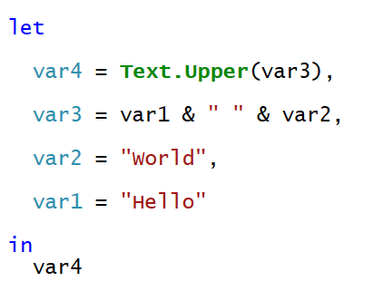
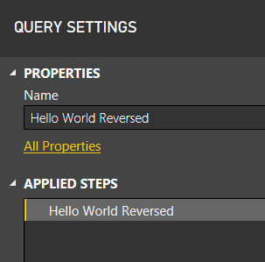
Will This M Code Work?
Yes, the Mashup Engine has no problem with this
The order of expressions in let block doesn't matter
However, the visual designer might get confused

Slide 18
Query Folding
Mashup engine pushes work back to datasource when possible
Column selection and row filtering
Joins, Group By, Aggregate Operations
Datasource that support folding
Relational database
Tabular and multidimensional databases
OData Web services
What happens when datasource doesn't support query folding?
All work is done locally by the mashup engine
Things that affect whether query folding occurs
The way you structure your M code
Privacy level of datasources
Native query execution

Slide 19
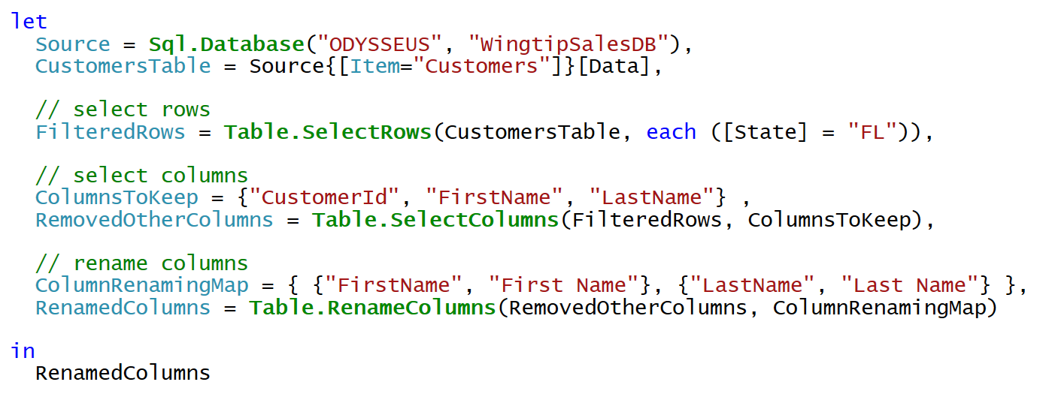
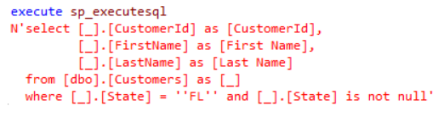
Query Folding Example
When you execute this query in Power BI Desktop…
Mashup Engine executes the following SQL query

Slide 20
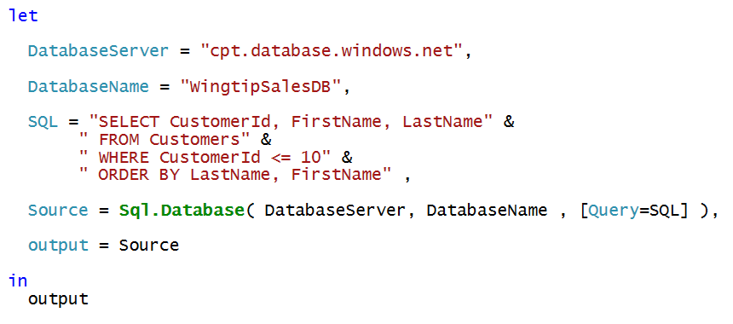
Native Queries
No query folding occurs after native query

Slide 21
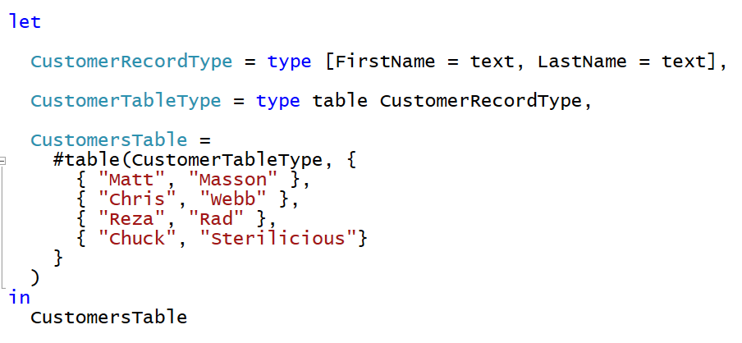
M Type System
Built-in types
any, none
null, logical, number, text, binary
time, date, datetime, datetimezone, duration
Complex types
list, record, table, function
User-defined types
You can create custom types for records and tables

Slide 22
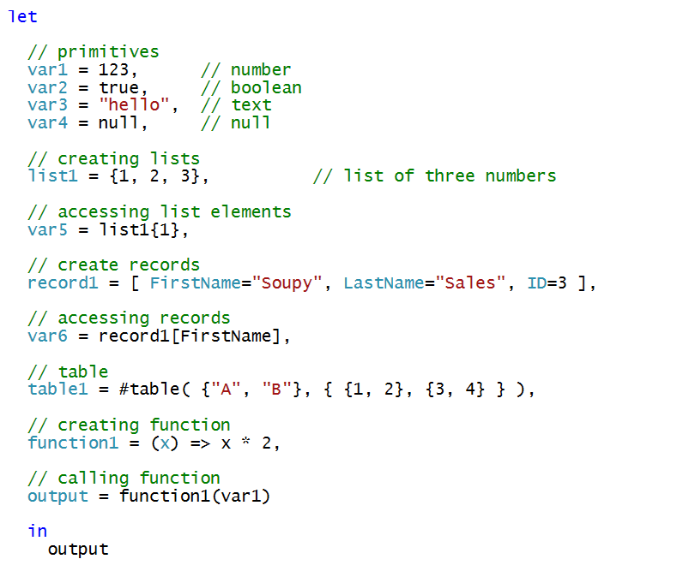
Examples of programming with M Datatypes

Slide 23
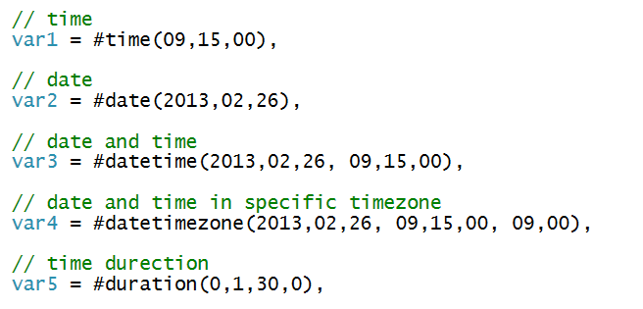
Initializing Dates and Times

Slide 24
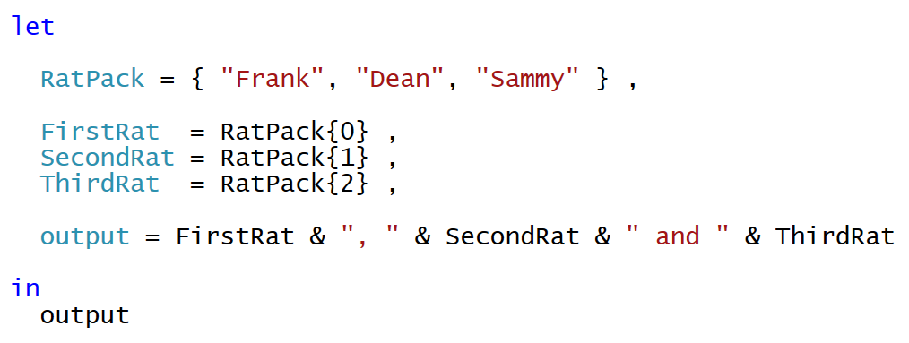
Lists
List is a single dimension array
Literal list can be created using { } operators
List elements accessed using { } operator and zero-based index
Use { }? to avoid error when index range is out-of-bounds

Slide 25
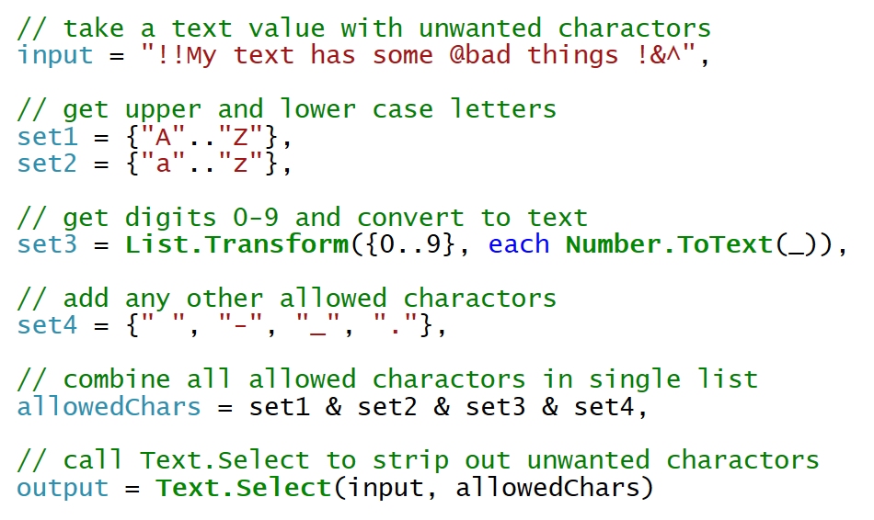
Text.Select
Text.Select can be used to clean up text value
You create a list of characters to include

Slide 26
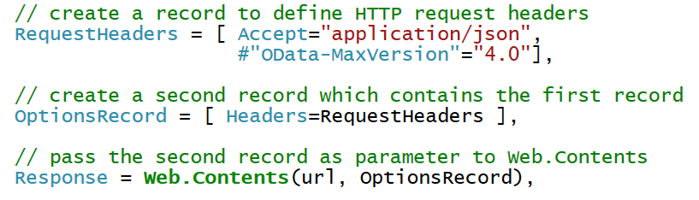
Records
Record contains fields for single instance of entity
You must often create records to call M library functions

Slide 27
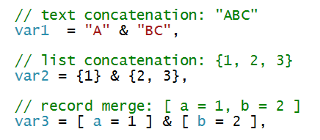
Combination Operator (&)
Used to combine strings, arrays and records

Slide 28
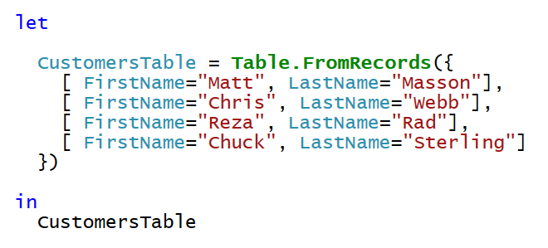
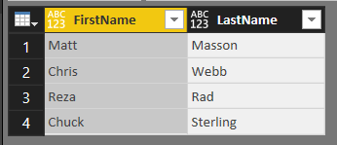
Table.FromRecords
Table.FromRecords can be used to create table
Table columns are not strongly typed
Bad, Bad, Bad ☹

Slide 29
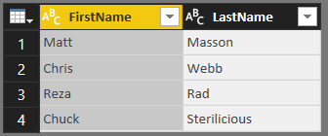
Creating User-defined Types
M allows you to create user-defined types
Here is a user-defined type for a record and a table
User-defined table used to create table with strongly typed columns

Slide 30

Using Each with Unary Functions
Many library functions take function as parameters
Function parameters are often unary (e.g. they accept 1 parameter)
M provides each syntax to make code easier to read/write
Unary parameter passed implicitly using _ variable
You can omit _ variable when accessing fields inside record
You must use _ variable when using each with a list

Slide 31
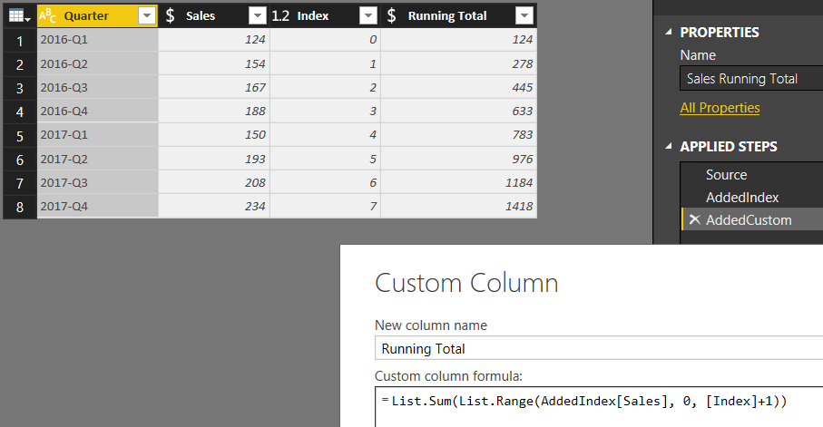
Performing Calculations Across Rows
Requires adding an index column

Slide 32
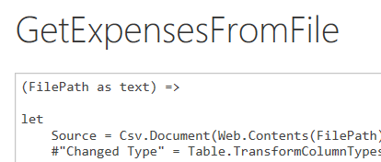
Understanding Function Queries
Query can be converted into reusable function
Requires editing query M code in Advanced Editor
Function query defined with one or more parameters
Function query can be called from other queries
Function query can be called using Invoke Custom Function
Function query can't be edited with visual designer

Slide 33
Agenda
The Power Query Mashup Engine
M Programming Fundamentals
Choosing Between OData.Feed & Web.Contents
Introduction to Custom Connectors
Importing Data from the Microsoft Graph API
Signing and Deploying Custom Connectors

Slide 34
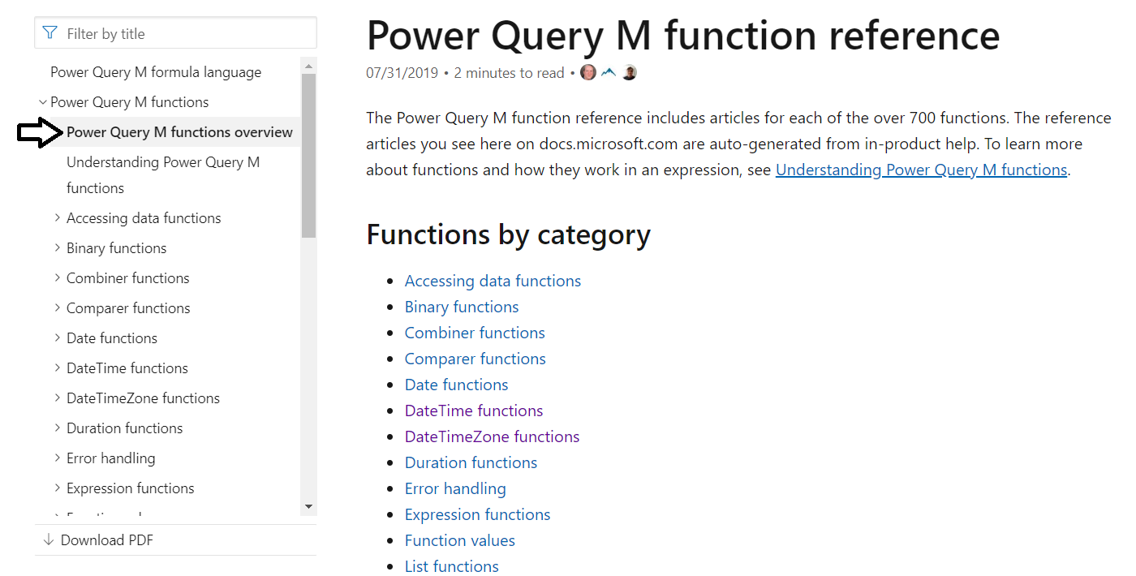
M Function Library
Check out the Power Query M function reference
https://docs.microsoft.com/en-us/powerquery-m/power-query-m-function-reference

Slide 35
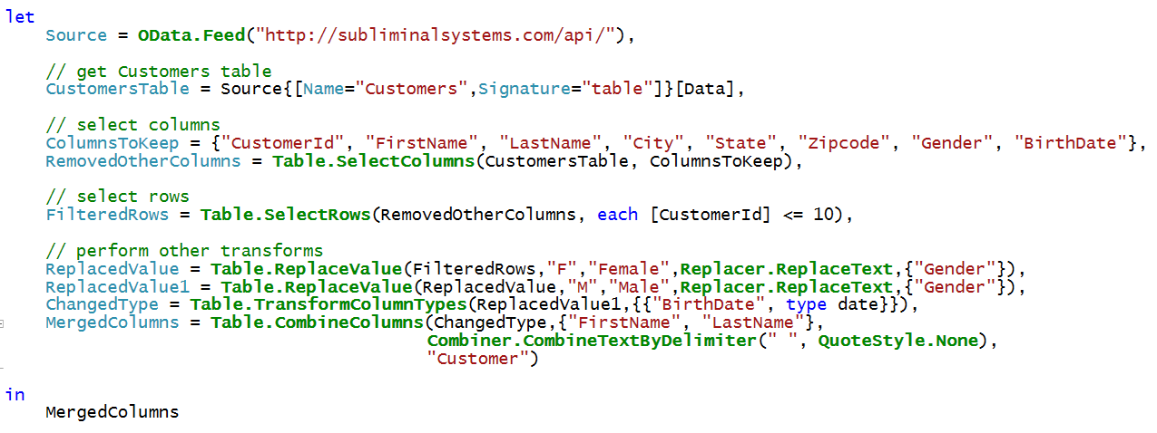
Accessing Data using OData.Feed
OData.Feed can pull data from OData web service
OData connector assists with navigation through entities
OData connector support query folding
OData makes extra calls to acquire metadata
Let's look at the execution of this query using Fiddler

Slide 36
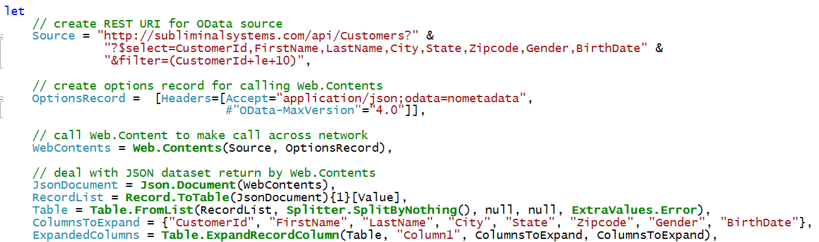
Web.Contents
Can be more efficient than OData.Feed
You can pass OData query string parameters (e.g. $select)

Slide 37
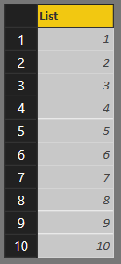
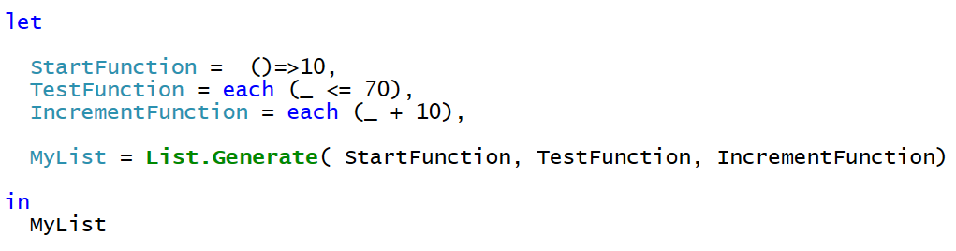
List.Generate
List.Generate accepts 3 function parameters
You can use each syntax for 2nd and 3rd parameter
You can optionally split functions out into separate expressions

Slide 38
Agenda
The Power Query Mashup Engine
M Programming Fundamentals
Choosing Between OData.Feed & Web.Contents
Introduction to Custom Connectors
Importing Data from the Microsoft Graph API
Signing and Deploying Custom Connectors

Slide 39
Developing Custom Data Connectors
Custom Connectors let you write reusable query logic
Custom connector is written using M programming language
Custom connector can be used across PBIX project files
Common motivation for developing a custom connector
Creating a friendly view of a REST API for business analyst
Providing branding on top of existing connector
Exposing a limited/filtered view over your data source
Control how mashup engine authenticates against datasource
Implementing OAuth v2 authentication flow for a SaaS offering
Enabling Direct Query for a data source via an ODBC driver`

Slide 40
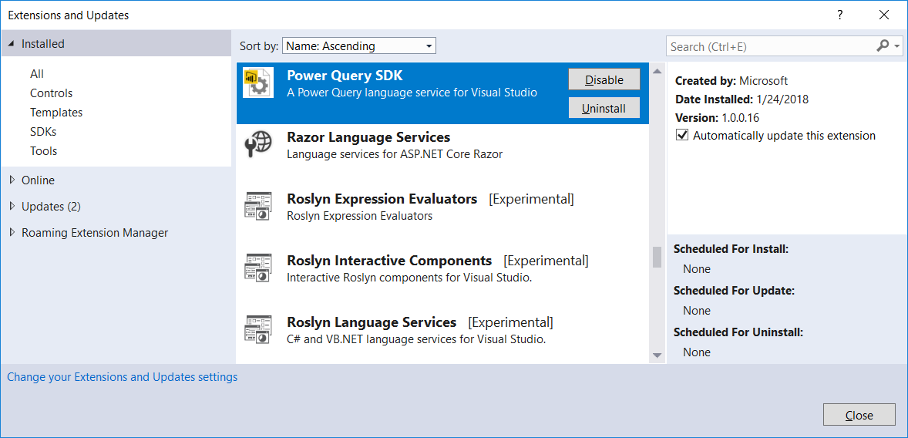
Power Query SDK

Slide 41
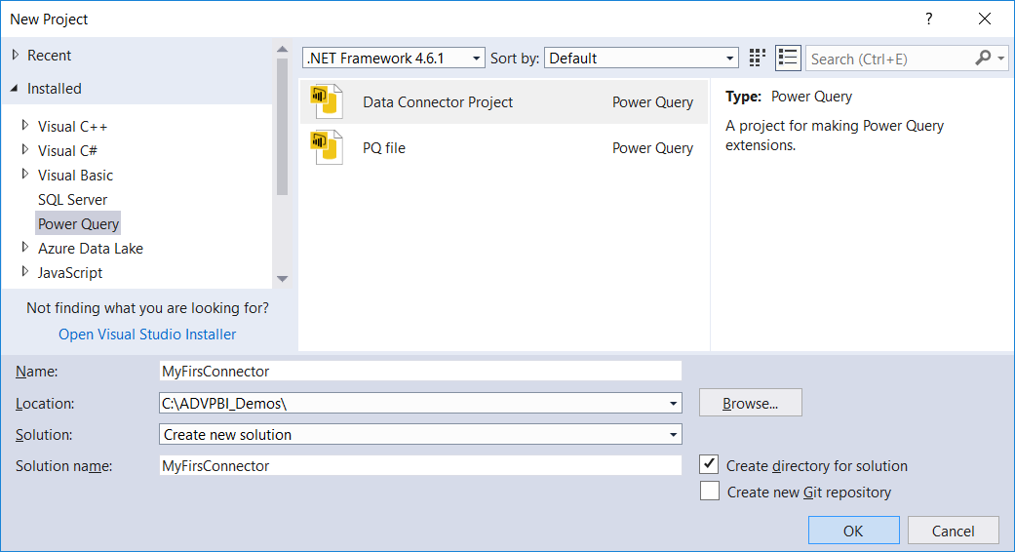
Creating a New Data Connector Project

Slide 42
Agenda
The Power Query Mashup Engine
M Programming Fundamentals
Choosing Between OData.Feed & Web.Contents
Introduction to Custom Connectors
Importing Data from the Microsoft Graph API
Signing and Deploying Custom Connectors

Slide 43
The Microsoft Graph API
Designed as a one-stop-shopping kind of service
Abstracts away divisions between AD, Exchange and SharePoint
No need to discover endpoints using the Discovery Service
You can acquire and cache a single access token per user
Azure AD Data
Users
Groups
Your Client Application
Outlook Data
Mail
Calendar
Contacts
Microsoft Graph API
https://graph.Microsoft.com
SharePoint Data
OneDrive Files
Team Site Files

Slide 44
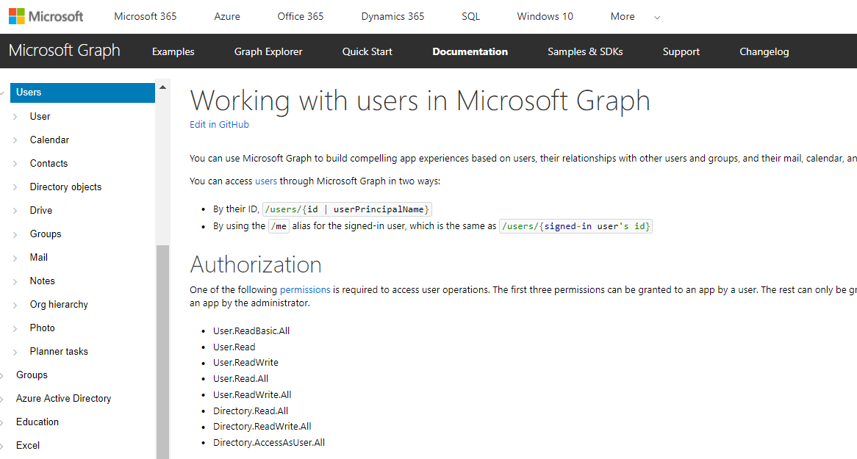
More Info on the Microsoft Graph API
https://developer.microsoft.com/en-us/graph/docs/api-reference/v1.0

Slide 45
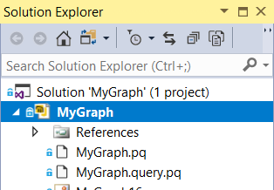
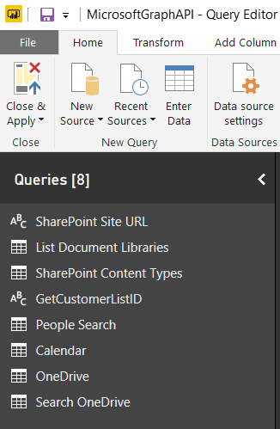
MyGraph Demo
Project originally created by Matt Masson
Connector designed to query Microsoft Graph API
Connector provides code to authenticate with OAuth2
Email Messages
Calendar Events
SharePoint Content
OneDrive Search
MyGraph.mez
OAuth2
Power BI Desktop Project
Custom Data Connector
Microsoft Graph API

Slide 46
Authorization Code Grant Flow
Sequence of Requests in Authorization Code Grant Flow
Application redirects to AAD authorization endpoint
User prompted to log on at Windows logon page
User prompted to consent to permissions (first access)
AAD redirects to application with authorization code
Application redirects to AAD access token endpoint
Request authorization code
Sign-in via browser pop-up
Return authorization code
Redeem authorization code and acquire access token for Office 365 resource
Return access token and refresh token
Call Microsoft Garph API using the access token
Return Http Response
Authorization Endpoint
Token Endpoint
Client Application
Microsoft Graph API

Slide 47
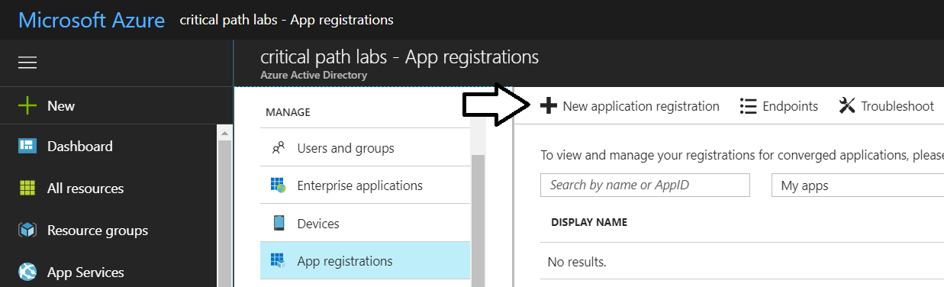
Registering an Azure Application
Can be done using Azure portal
Details you need for the custom data connector
Client ID
Client Secret
Redirect URL

Slide 48
Agenda
The Power Query Mashup Engine
M Programming Fundamentals
Choosing Between OData.Feed & Web.Contents
Introduction to Custom Connectors
Importing Data from the Microsoft Graph API
Signing and Deploying Custom Connectors

